Slide 1








Sask K of C Charitable Foundation
Vocations Endowment
IN Partnership with
Archdiocese of Regina
Archdiocese of Keewatin La Pas
Diocese of Saskatoon
Diocese of Prince Albert
Eparchy of Saskatoon
St. Peters’ Abbey

Slide 2
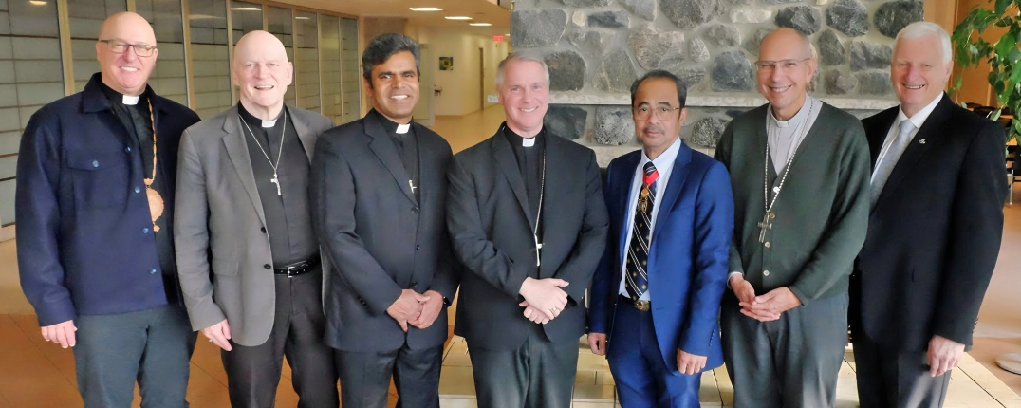
(L to R) Bishop Michael Smolinski; Bishop Mark Hagemoen; Archbishop-Elect Susai Jesu; Bishop Stephen Hero; State Deputy Marte Clemont Nogot; Archbishop Donald Bolen; and Sask K of C Charitable Foundation President Harvey Granatier

Slide 3
Vocations Endowment History
The K of C Vocation Endowment provides equal disbursements annually to each Saskatchewan Seminarian
In 2021 each of the 8 Saskatchewan Seminarians received $4,000.00
In 2022 each of the 13 Saskatchewan Seminarians received $4,000.00
In 2023 each of the 10 Saskatchewan Seminarians received $5,170.00
In 2024 each of the 7 Saskatchewan Seminarians received $8,600.00
In 2025 each of the 7 Saskatchewan Seminarians received $9,100.00
Currently there are 8 Saskatchewan Seminarians

Slide 4
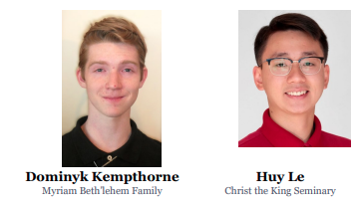

2025-2026 Saskatchewan Seminarians

Slide 5
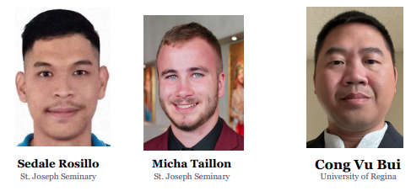
2025-2026 Saskatchewan Seminarians

Slide 6
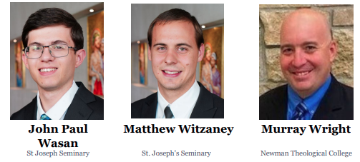
2025-2026 Saskatchewan Seminarians

Slide 7
Please prayerfully consider investing in the education and formation of our Saskatchewan seminarians
EFT – eTransfers
donations@saskkofc.foundation
Security Question: Knights of
Answer: Columbus
Message: Vocations
Credit Card – online
www.saskkofc.foundation
Tab – Donate Now
Cheques – payable to “Sask KofC Charitable Foundation”
Box 61, Moose Jaw, SK. S6H 4N7

